Slide 1

Economic Regulator: Options and Models Report
Definition, scope, functions and options
15 February 2013

Slide 2
Content
Definition of Economic Regulation
Scope of Economic Regulation
Regulatory Models/ Options
Criteria for assessment

Slide 3
Problem statement
Current tariff and charge setting process lacks regulation;
Raw water:
  Conflict of interest (DWA determines raw water pricing strategy, sets raw water tariffs, is infrastructure developer and operator, spends revenue from tariffs)
  Difficult to correlate expenditure with charge elements
  TCTA charge not effectively regulated
  WRM charge to be determined by CMAs – will need regulation to avoid uneccesary escalation
Water services
  Weak regulation of water board tariffs
    may result in over-pricing (consumer pays more than is appropriate) or
    under-pricing (with associated under-funding of operation, maintenance and refurbishment)
  Local government tariffs
    Section 10 regulations – poorly enforced?
    Little ring-fencing of water services budgets
    Many WSAs do not know their full costs to budget against

Slide 4
Definition of ER
“setting the rules to control, monitor, enforce and change allowed tariffs and service standards for the water sector whilst giving due regard to social, environmental and economic imperatives”

Slide 5
Objectives of Economic Regulation
Main objectives:
  Protect customers
  Protect water institutions
  Enable public sector to carry out long term objectives
Directed at regulating
  costs (tariffs) charged and
  service standards
Must take into accoutn social/equity imperatives
  Will require cross-subsidisation or pro-poor support

Slide 6
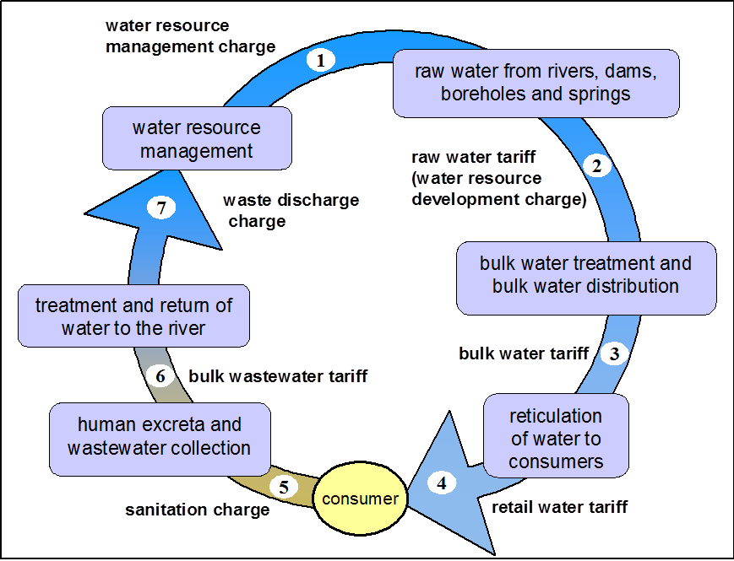
ER Scope
ER must cover the whole Water Value Chain

Slide 7
ER Scope (Cont.)
 | Function | Regulated institution
1 | Determining water resources management charge | DWA (responsibility of CMAs once delegated)
2 | Determining water resource development charge | DWA/ TCTA
3 | Determining bulk water tariff | Bulk water services providers (WB, some WSAs & intermediaries)
4 | Determining retail water tariff/service standards (within constraints of constitutional roles | Municipalities
4 | Determining sanitation charges/ service standards (within constraints of constitutional roles) | Municipalities
6 | Determining bulk waste water treatment charges/service standards (within constraints of constitutional roles) | Municipalities (WSAs) and some water boards (domestic and industrial waste
7 | Determining Waste Discharge Charges | DWA (not yet implemented)
8 | Determining water research charges | WRC

Slide 8
ER Scope (Cont.)
Where DWA, TCTA, Water Boards or CMAs are setting charges, the ER can determine what those charges should be;
Where municipalities (Water Services Authorities) are setting tariffs, the role of the ER is less clear
  the ER can ensure that national norms and standards are met in line with the constitution, but cannot interfere in the decisions that affect the running of a municipality

Slide 9
ER Functions
Regulatory scope | Regulatory function/s | Regulatory objective | Regulatory overlaps
1 Water resource management charges - DWA/CMAs | Set rules for raw water management charges determination. Approve raw water management charges | Ensure reasonable charges to archive catchment objectives | Environmental / social (CMS)
 |  | Sustainability of institutions
2 Water resource development charge -DWA /TCTA | Set rules for raw water management charges (raw water tariff) determination. Approve raw water management charges/tariff | Ensure reasonable charges
 |  | Sustainability of institutions
 |  | Consumer/user protection | Environmental
 |  | Strategic asset management
 | Raw water quality service standards | Raw water quality | Environmental/CMS
 | Regulatory review | Deal with Disputes/appeals

Slide 10
Regulatory scope | Regulatory function/s | Regulatory objective | Regulatory overlaps
3 Bulk water tariff/services | Set rules for determination of bulk potable water Tariffs. Approve bulk potable water tariffs | Ensure reasonable charge for bulk potable water customer
 | Assess compliance with drinking water quality standards | Meet SANS 241 ( Blue drop) | Health
 | Set rules for determination of bulk raw water tariffs. Approve bulk raw water tariffs Raw water quality standards | Ensure reasonable charge for bulk water raw water customers
 |  | Sustainability of institutions
 | Assess reliability of supply | Norms and standards met/ review
 | Customer protection | Norms and standards met/ review
 | Monitor efficiency and serviceability of supply | Specifying asset conditions Specifying efficiency and or performance targets | Technical impacts
 | Regulatory Review | Deal with Disputes/appeals

Slide 11
ER Functions (cont.)
Regulatory scope | Regulatory function/s | Regulatory objective | Regulatory overlaps
Sanitation Charges/ services | Set rules for determination of sanitation charges (tariffs). Approve sanitation charges (tariffs). Assess compliance with sanitation charges (tariffs) Determine rules and make recommendations | Ensure reasonable charge for sanitation customers
 |  | Sustainability of institutions
 | Monitor reliability of service | Norms and standards met
 | Customer protection | Norms and standards met
 | Monitor efficiency and serviceability of supply | Specifying asset conditions Specifying efficiency and or performance targets | Technical

Slide 12
ER Functions (cont.)
Regulatory scope | Regulatory function/s | Regulatory objective | Regulatory overlaps
5. Sanitation Charges/ services | Set rules for determination of sanitation charges (tariffs). Approve sanitation charges (tariffs). Assess compliance with sanitation charges (tariffs) determination rules and make recommendations | Ensure reasonable charge for sanitation customers
 |  | Sustainability of institutions
 | Monitor reliability of service | Norms and standards met
 | Customer protection | Norms and standards met
 | Monitor efficiency and serviceability of supply | Specifying asset conditions Specifying efficiency and or performance targets | Technical
 | Monitor service coverage | Service coverage targets met | Social

Slide 13
ER Functions (cont.)
Regulatory scope | Regulatory function/s | Regulatory objective | Regulatory overlaps
6. Bulk waste water charges/ services | Set rules for determination of bulk sanitation charges (tariffs). Approve bulk sanitation charges (tariffs). Assess compliance with retail tariff determination rules and make recommendations | Ensure reasonable charge for sanitation customers
 |  | Sustainability of institutions
 | Monitor reliability of service | Norms and standards met
 | Customer protection | Norms and standards met
 | Monitor efficiency and serviceability of supply | Specifying asset Conditions Specifying efficiency and or performance targets | Technical
 | Regulatory review | Deal with Disputes/appeals

Slide 14
ER Functions (cont.)
Regulatory scope | Regulatory function/s | Regulatory objective | Regulatory overlaps
7. Waste discharge charge | Set rules for waste discharge charges determination. Approve waste discharge management charges (Green Drop) | Ensure reasonable charges | Environmental
 |  | Sustainability of institutions
 | Regulatory review | Deal with Disputes/appeals
8. International agreements/ charges | Set rules for review existing raw water tariff charges | Ensure reasonable charges | Environmental
 |  | Sustainability of institutions
 | Set rules for determination of raw water tariffs for new schemes/ agreements Approve new raw water tariffs | Ensure reasonable charges | Environmental
 |  | Sustainability of institutions
 | Regulatory review | Deal with Disputes/appeals

Slide 15
Regulatory Options: Introduction
What is the optimal corporate form for the performance of ER?
corporate forms governed by the PFMA & PSA
1. Dedicated departmental ER Branch/Unit
2. Government Component
3. Public Entity
Must consider possible corporate forms in the context of the functions that the ER must perform, & particularly the core purpose of regulating tariff & charge setting along the WVC

Slide 16
Regulatory Option 1: Internal to DWA
ER function performed by DWA
No change to corporate form
Internal restructuring to create dedicated ER branch/unit within branch
Establishment of dedicated regulatory branch – approved in Jan 13 with separate units for the following domains
      CDs for each regulatory domain
        Compliance monitoring
        Enforcement
        Waters services regulation

Slide 17
Regulatory Option 1: Internal to DWA
The new branch does not have a dedicated ER branch targeting charges/institutions along the entire WVC
2 options under Option 1-
  Option 1a – ER Branch
    Branch headed by DDG
  Option 1b – an ER unit within the newly established branch
    Unit headed by Chief Director

Slide 18
Regulatory Option 1: Internal to DWA
Requirements for this option:
  Current & new ER functions will have to be consolidated
  Enforcement capability of DWA must be strengthened
  The ER functions would need to be re-organised
  New posts required & appropriate budget allocated to the ER function
  Need to strengthen the current levels of ER capacity
  No need for legislation to establish ER branch/unit
  NWA, WSA, Structures Act, Systems Act may require significant amendments to give Minister ER powers
  Capacity of regulated bodies needs to be progressively built over time

Slide 19
Regulatory Option 1: Internal to DWA
Advantages
  Enables a degree of separation of ER function from policy, support & implementation roles of DWA
  Provides a basis for more focussed ER activities
  Can be implemented quickly, subject to proposed scope & functions that require amendments to the NWA and WSA
  Incremental approach, building on current functions over time
  Close alignment between the policy imperatives of DWA & implementation of policy imperatives through ER
  No assignment/ delegation of functions necessary
  Can make use of DWA’s corporate services
  Advisory Committee may be established to advise the Minister on service delivery matters and/or to accommodate stakeholder interests (applicable to all options)

Slide 20
Regulatory Option 1: Internal to DWA
Disadvantages
  Does not fully resolve conflict of interest role within DWA in terms of setting and regulating water resource charges.
  Does not resolve difficulty of recruiting & retaining highly skilled technical staff

Slide 21
Regulatory Option 2: Government Component
Would be a separate institution within DWA, with own accounting officer/Head of Component at DG level
Directly accountable to Minister
Allows for the delegation/ assignment of government functions to an organisation within the public service
Under direct control of a Head of Component (HoC)
May have its own administrative resources e.g. HR, Finance, or it can share these resources with DWA
May have original statutory powers or assigned or delegated statutory powers and duties
DWA can assist Minister to exercise oversight over the GC on policy implementation, performance, integrated planning, budgeting & service delivery
Falls within the Budget Vote of DWA & may receive transfer payments from DWA

Slide 22
Regulatory Options (cont.)
Option 2: Process to establish GC
  Min may only request the establishment of a GC if the prescribed feasibility is conducted & its findings recommend the establishment
  Feasibility study includes:
    Option analysis of organizational forms
    Business case of preferred option
    Government Notice
  Inter-departmental Evaluation Committee makes recommendation
  Minister PSA and Minister Finance advise Minister DWA on establishment and amendments to business case or Government Notice.
  DPSA process Proclamation to list in PSA.

Slide 23
Regulatory Option 2: GC (cont.)
Advantages of GC
  Allows a good balance between having an ER that is separate from DWA but linked to it for purposes of oversight & achieving alignment with the government mandate
  Allows for good governance as the HoC = accounting officer for the ER function alone & will be able to focus strongly on this specific & complex function.
  The HoC has a similar standing to that of the DG of DWA
  Direct control and influence by the Min over service delivery outcomes and outputs without the need to create an entity outside the public service;
  GC will be able to focus its HR component on the recruitment, training and retention of staff with the specific skills required for ER;
  Can take between 9 to 18 months to establish depending on the length of time to get the necessary Act through Parliament;
  Legal status – remains part of the government, similar to that of principal department
  Has just as much power as an external entity, without the separate legal status

Slide 24
Regulatory Option 2: GC (cont.)
Option 2: disadvantages of GC
  Specific regulatory functions will have to be conferred, assigned or delegated
  Assignment of functions to the GC subject to approval by Parliament
  Not clear is the GC can take legal action against DWA, if necessary
  Attraction and retention of staff limited by public service conditions and salaries

Slide 25
Regulatory Option 3: External to DWA
National Public Entity (NPE)
  This option entails the Economic Regulation function being performed by an institution external to DWA
  Definition of PE
  (b) a board, commission, company, corporation, fund or other entity (other than a national government business enterprise) which is—
      (i) established in terms of national legislation;
  (ii) fully or substantially funded either from the National Revenue Fund, or by way of a tax, levy or other money imposed in terms of national legislation; and
          (iii) accountable to Parliament;

Slide 26
Regulatory Option 3: External to DWA cont.)
  Prescribed by law & serves identified ‘public purpose’ objectives
  Forms part of the “general government”, & not the “business sector”
  Juristic person with a governing board
  Has limited recourse to the resources & authority of the State
  Governing Board is accountable to Parliament through the Minister & the NPE forms part of a Minister’s “portfolio” of executive responsibilities
  Governance arrangements are specified in:
    enabling legislation
    various codes & protocols (King Code, Protocol on Corporate Governance)
  Enjoys separate legal status from DWA and other government departments and entities
  Functions & powers of the ER would be directly assigned through establishing legislation.
  Once established it must be listed as a NPE in Schedule 2 of the PFMA.

Slide 27
Regulatory Option 3: External to DWA
Advantages of NPE
  Largely resolves the player / referee challenge within DWA
  Falls outside the public service regulations & can therefore pay higher salaries, provide better working conditions, & is better placed to recruit & retain highly skilled individuals
  As a separate juristic person it is better placed to take legal action against DWA & municipalities if required
  Clear separation of roles & responsibilities
  Perceived as being less open to inappropriate government influence
  Could still obtain transfer payment from DWA supplemented by a portion of water use charges

Slide 28
Regulatory Option 3: External to DWA
Disadvantages of NPE
  More complicated to establish & may take between 2 to 3 years
  Generally more expensive than the options internal to the public service

Slide 29
CRITERIA FOR ASSESSMENT OF MOST APPROPRIATE CORPORATE FORM
Regulatory legitimacy
Is the action or regime supported by legislative authority
Is there an appropriate scheme of accountability
Are procedures fair, accessible and open
Is the regulator acting with sufficient expertise
Is the action or regime efficient
Regulatory Best Practice (Do the options address regulatory principles?)
Clear Roles
Transparency Accountability/Non discriminatory
Independence/Autonomy
Participation
Effective Monitoring and Enforcement
Minimal Regulation
Predictability
Judicial review
Market structure fit (Does the option facilitate? )
Building on existing regulatory capacity and structures
Progressively building regulatory capacity within the sector institutions.
Introducing more appropriate separation of roles and responsibilities
Addressing existing critical regulatory gaps and constraints.
Ensuring that the existing water sector “market failures” are addressed on a priority basis.
Enables “quick wins” to be made.
Accommodates the regulatory preferences of key sector stakeholders

Slide 30
THANK YOU

